Slide 1
Limits as x goes to infinity or negative infinity

Slide 2
We previously discussed how to evaluate limits as x goes to infinity or as x goes to negative infinity using a graphing approach.
However, we can discuss how to evaluate these types of limits without using a graphing approach every time.
To discuss how to do this, we will look at some graphs.
It is NOT important to know the numbers of the scenarios that follow.

Slide 3

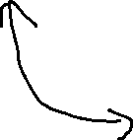
Scenario 1
Suppose $y=a^{x}, 0<a<1$
For example, suppose $y={\left(\frac{1}{2}\right)}^{x}$

Slide 4
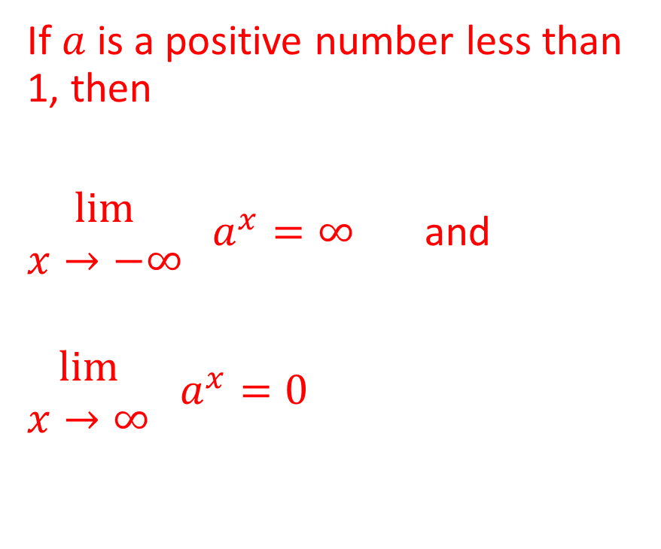
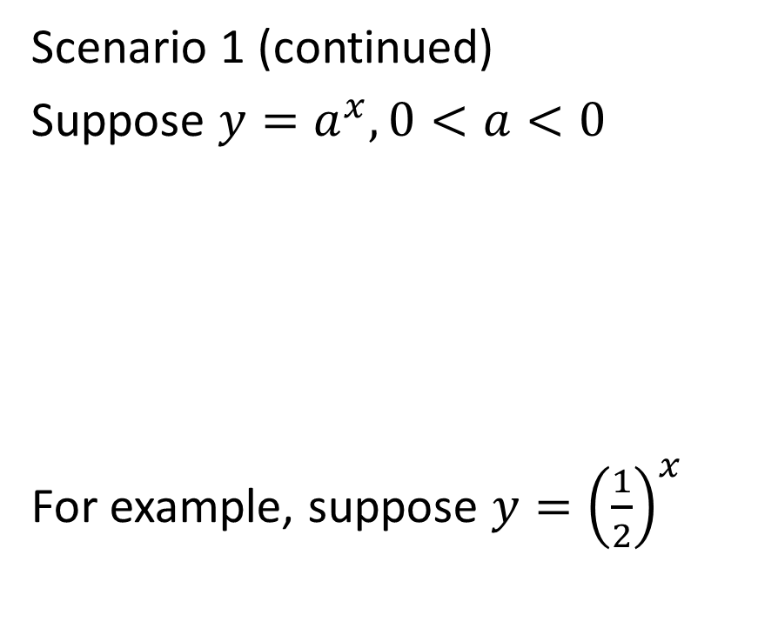
Scenario 1 (continued)
Suppose $y=a^{x}, 0<a<0$
For example, suppose $y={\left(\frac{1}{2}\right)}^{x}$
If $a$ is a positive number less than 1, then
$\begin{matrix}lim⁡ \\ x→−∞\end{matrix} a^{x}=∞$ and
$\begin{matrix}lim⁡ \\ x→∞\end{matrix} a^{x}=0$

Slide 5

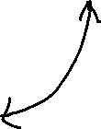
Scenario 2
Suppose $y=a^{x}, a>1$
For example, suppose $y={\left(2\right)}^{x}$

Slide 6

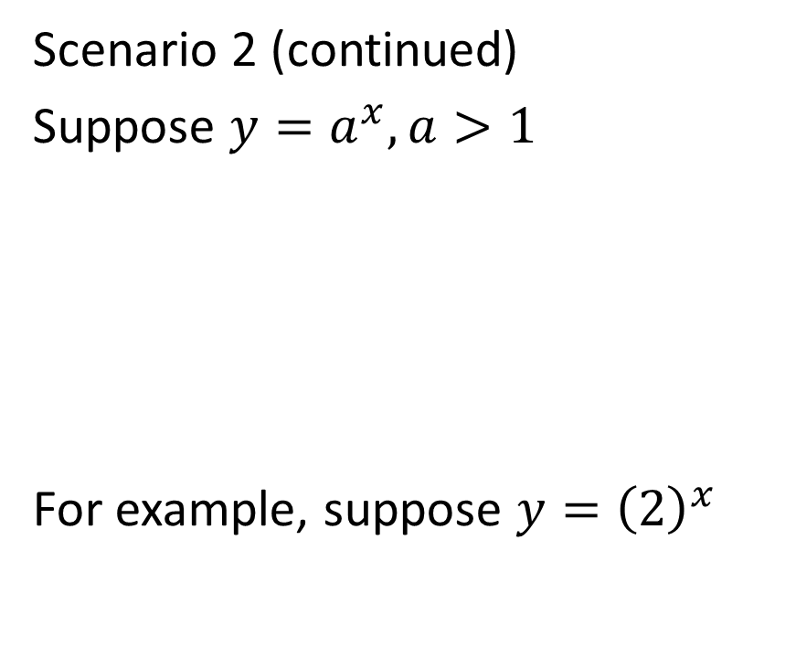
Scenario 2 (continued)
Suppose $y=a^{x}, a>1$
For example, suppose $y={\left(2\right)}^{x}$
If $a$ is a number greater than 1, then
$\begin{matrix}lim⁡ \\ x→−∞\end{matrix} a^{x}=0$ and
$\begin{matrix}lim⁡ \\ x→∞\end{matrix} a^{x}=∞$

Slide 7


Scenario 3
Suppose $y=a^{x}, a=1$
In other words, suppose $y={\left(1\right)}^{x}$

Slide 8

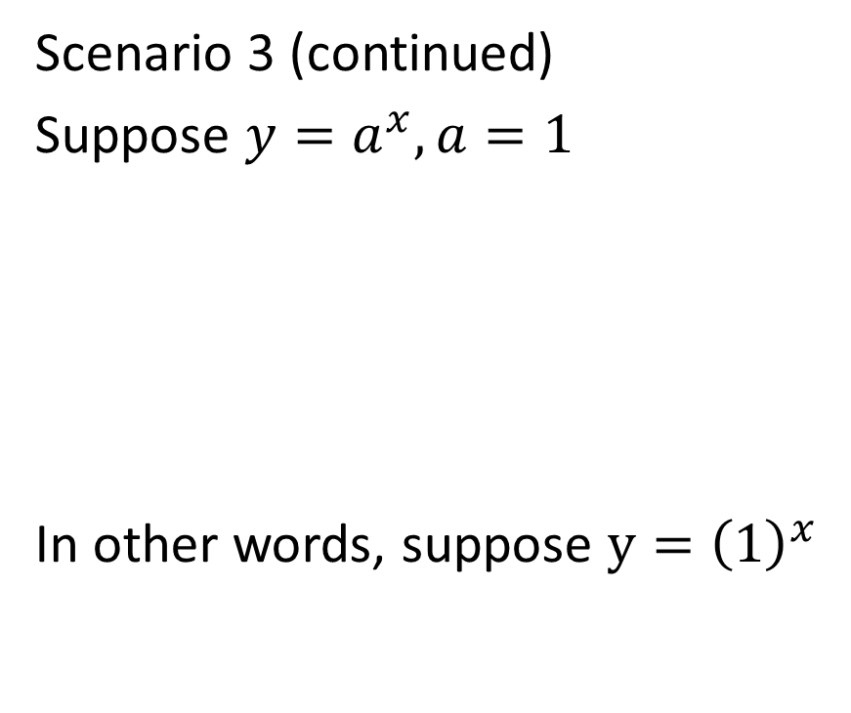
Scenario 3 (continued)
Suppose $y=a^{x}, a=1$
In other words, suppose $y={\left(1\right)}^{x}$
If $a=1$, then
$\begin{matrix}lim⁡ \\ x→−∞\end{matrix} a^{x}=1$ and
$\begin{matrix}lim⁡ \\ x→∞\end{matrix} a^{x}=1$

Slide 9
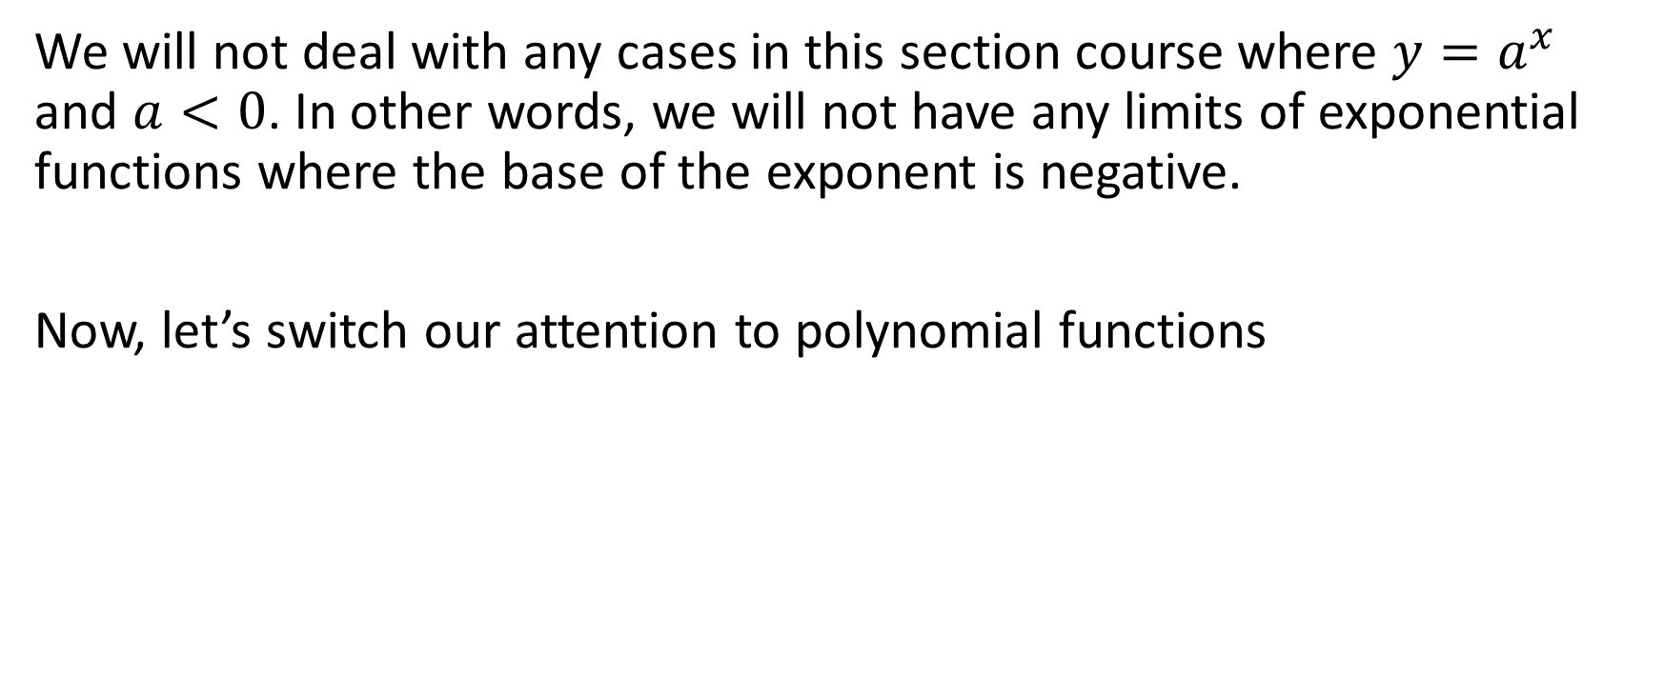
We will not deal with any cases in this section course where $y=a^{x}$ and $a<0$. In other words, we will not have any limits of exponential functions where the base of the exponent is negative.
Now, let’s switch our attention to polynomial functions

Slide 10

Scenario 4
Suppose $y=x^{a}, a>0$

Slide 11
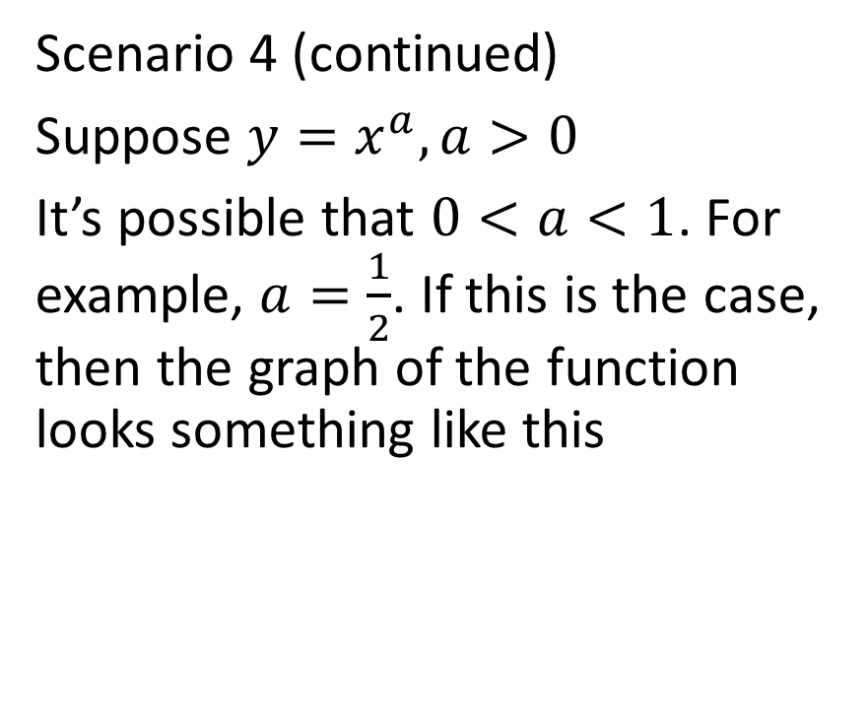

Scenario 4 (continued)
Suppose $y=x^{a}, a>0$
It’s possible that $0<a<1$. For example, $a=\frac{1}{2}$. If this is the case, then the graph of the function looks something like this

Slide 12
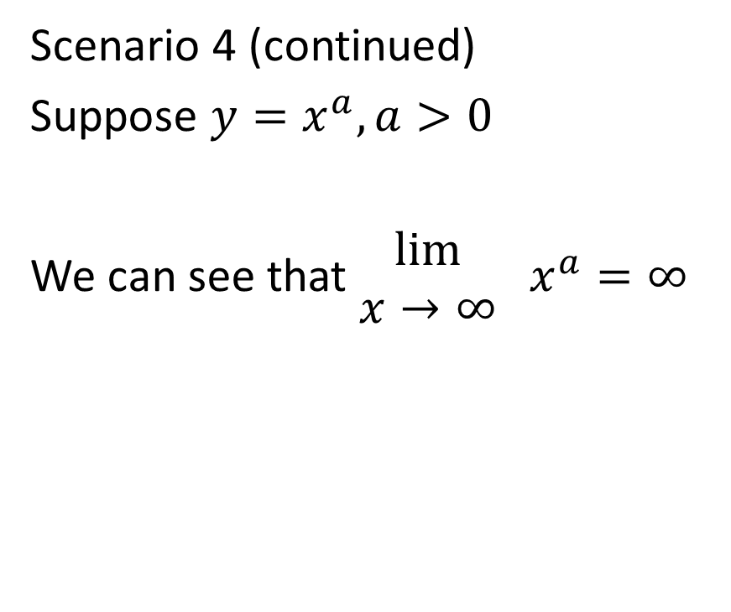
Scenario 4 (continued)
Suppose $y=x^{a}, a>0$
We can see that $\begin{matrix}lim⁡ \\ x→∞\end{matrix} x^{a}=∞$

Slide 13
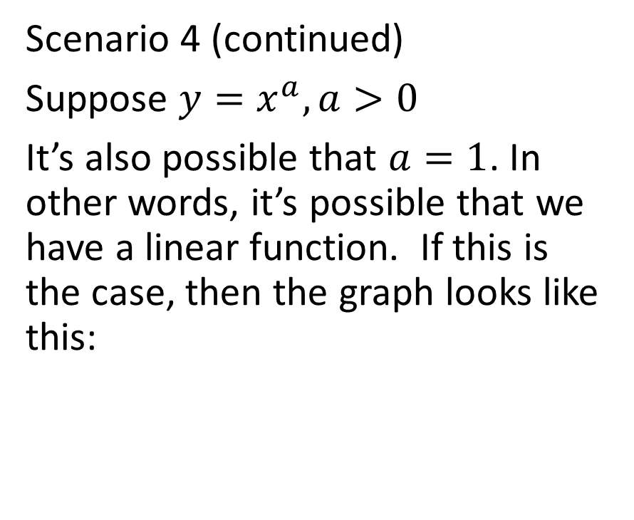

Scenario 4 (continued)
Suppose $y=x^{a}, a>0$
It’s also possible that $a=1$. In other words, it’s possible that we have a linear function. If this is the case, then the graph looks like this:

Slide 14
Scenario 4 (continued)
Suppose $y=x^{a}, a>0$
We can see that $\begin{matrix}lim⁡ \\ x→∞\end{matrix} x^{a}=∞$

Slide 15
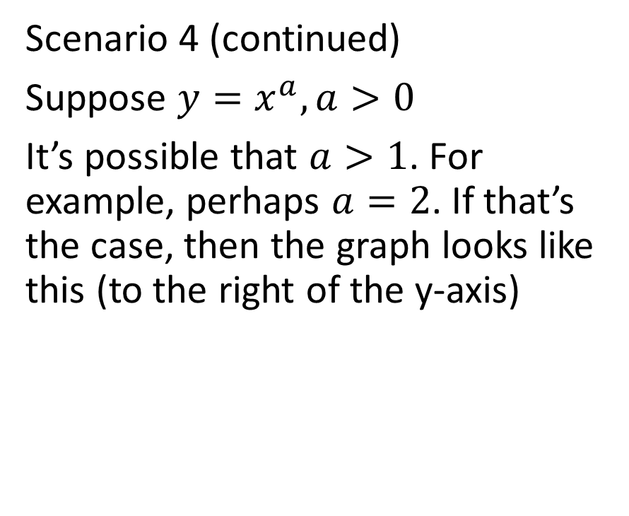

Scenario 4 (continued)
Suppose $y=x^{a}, a>0$
It’s possible that $a>1$. For example, perhaps $a=2$. If that’s the case, then the graph looks like this (to the right of the y-axis)

Slide 16
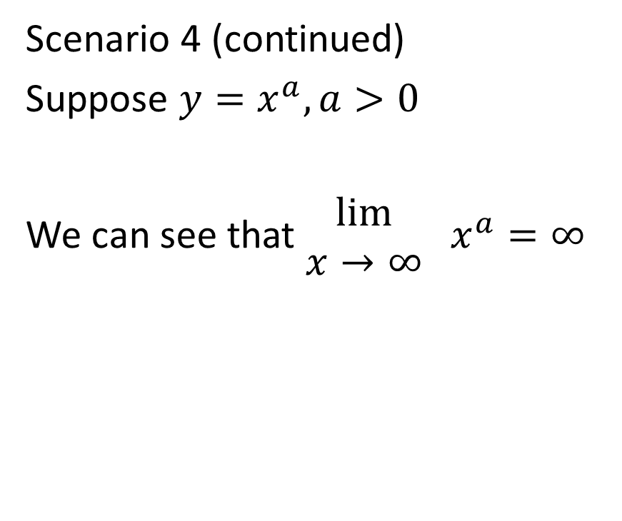
Scenario 4 (continued)
Suppose $y=x^{a}, a>0$
We can see that $\begin{matrix}lim⁡ \\ x→∞\end{matrix} x^{a}=∞$

Slide 17
Scenario 4 (continued)
Suppose $y=x^{a}, a>0$
We can see that $\begin{matrix}lim⁡ \\ x→∞\end{matrix} x^{a}=∞$
Putting all three of the cases in Scenario 4 together, we see that …

Slide 18
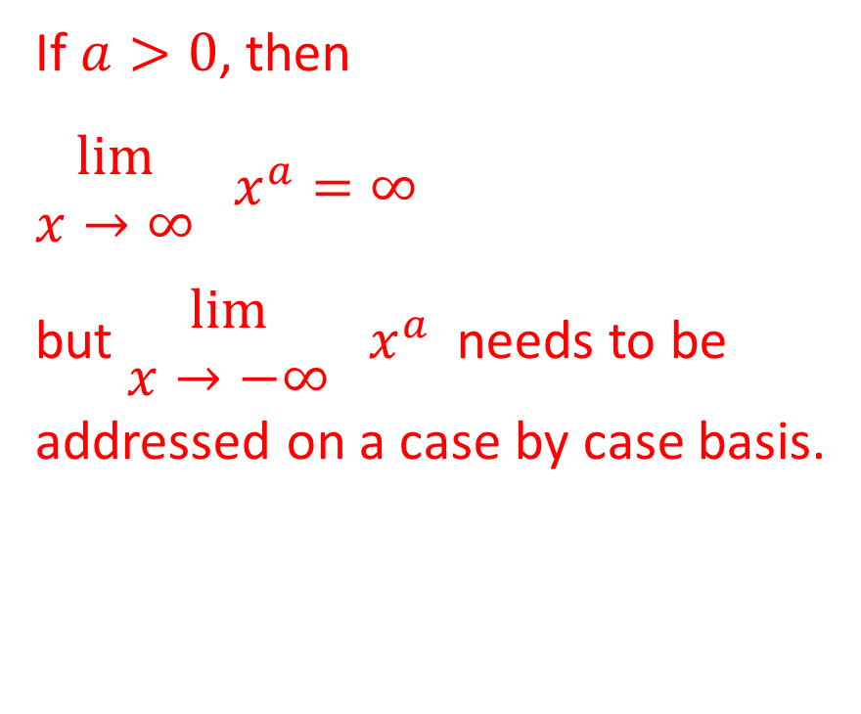
Scenario 4 (continued)
Suppose $y=x^{a}, a>0$
We can see that $\begin{matrix}lim⁡ \\ x→∞\end{matrix} x^{a}=∞$
If $a>0$, then
$\begin{matrix}lim⁡ \\ x→∞\end{matrix} x^{a}=∞$
but $\begin{matrix}lim⁡ \\ x→−∞\end{matrix} x^{a}$ needs to be
addressed on a case by case basis.

Slide 19
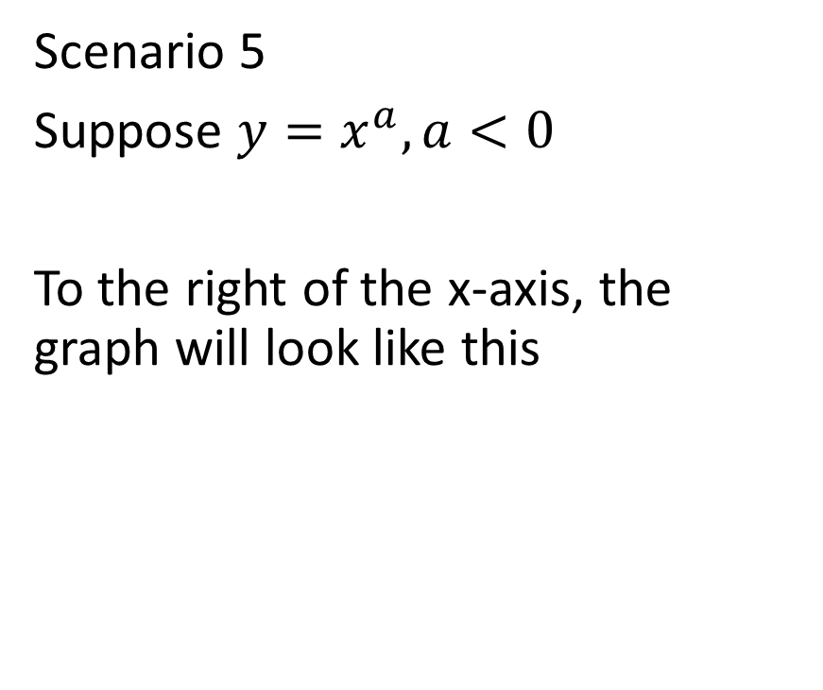

Scenario 5
Suppose $y=x^{a}, a<0$
To the right of the x-axis, the graph will look like this

Slide 20

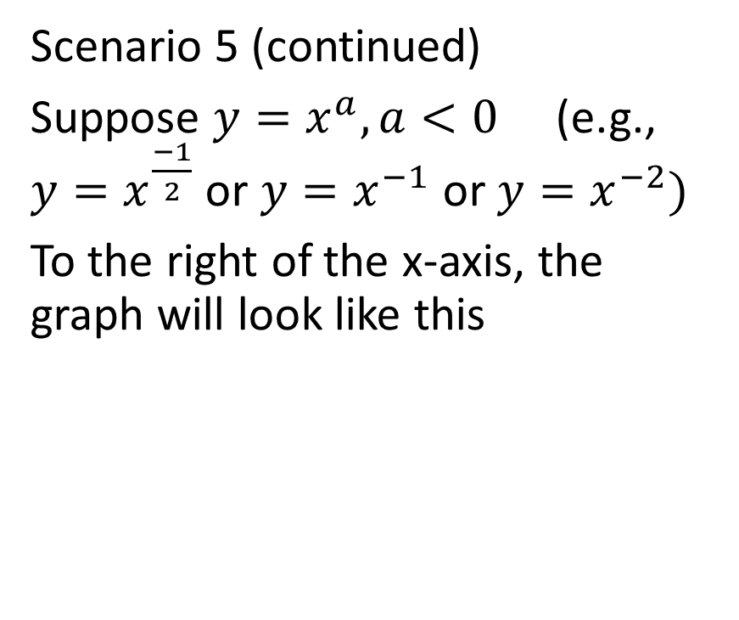
Scenario 5 (continued)
Suppose $y=x^{a}, a<0$ (e.g., $y=x^{\frac{−1}{2}}$ or $y=x^{−1}$ or $y=x^{−2})$
To the right of the x-axis, the graph will look like this
If $a<0$, then
$\begin{matrix}lim⁡ \\ x→∞\end{matrix} x^{a}=0$
but $\begin{matrix}lim⁡ \\ x→−∞\end{matrix} x^{a}$ needs to be
addressed on a case by case basis.

Slide 21
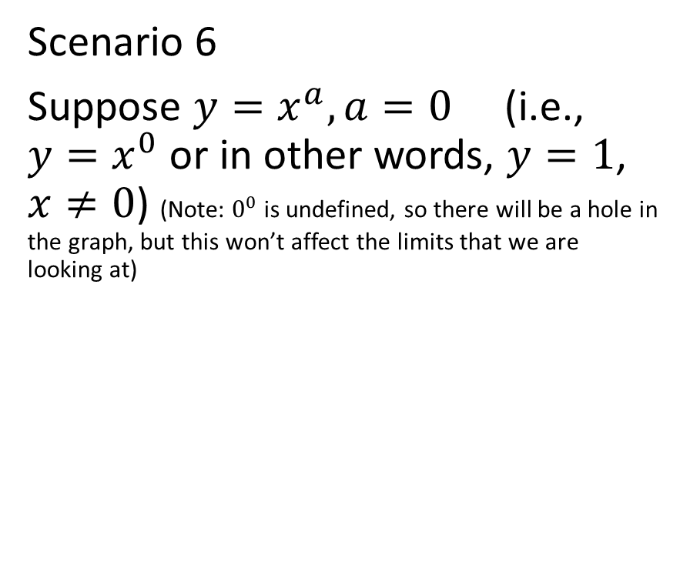
Scenario 6
Suppose $y=x^{a}, a=0$ (i.e., $y=x^{0}$ or in other words, $y=1$, $x≠0$) (Note: $0^{0}$ is undefined, so there will be a hole in the graph, but this won’t affect the limits that we are looking at)

Slide 22


Scenario 6 (continued)
Suppose $y=x^{a}, a=0$ (i.e., $y=x^{0}$ or in other words, $y=1$, $x≠0$)

Slide 23

Scenario 6 (continued)
Suppose $y=x^{a}, a=0$ (i.e., $y=x^{0}$ or in other words, $y=1$, $x≠0$)
If $a=0$, then
$\begin{matrix}lim⁡ \\ x→∞\end{matrix} x^{a}=1$
and
$\begin{matrix}lim⁡ \\ x→−∞\end{matrix} x^{a}=1$

Slide 24

Example
Evaluate $\begin{matrix}lim⁡ \\ x→−∞\end{matrix} \frac{6^{x}}{7^{x}}$

Slide 25
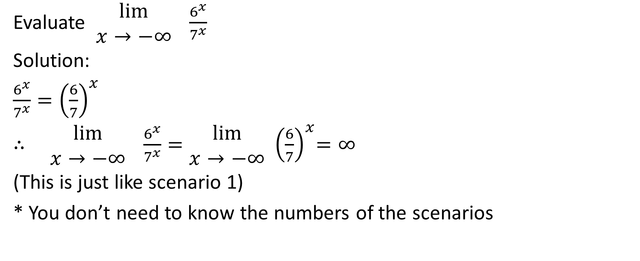

Evaluate $\begin{matrix}lim⁡ \\ x→−∞\end{matrix} \frac{6^{x}}{7^{x}}$
Solution:
$\frac{6^{x}}{7^{x}}={\left(\frac{6}{7}\right)}^{x}$
$∴ \begin{matrix}lim⁡ \\ x→−∞\end{matrix} \frac{6^{x}}{7^{x}}=\begin{matrix}lim⁡ \\ x→−∞\end{matrix}$ ${ \left(\frac{6}{7}\right)}^{x}=∞$
(This is just like scenario 1)
* You don’t need to know the numbers of the scenarios

Slide 26

Example
Evaluate $\begin{matrix}lim⁡ \\ x→∞\end{matrix} \frac{6^{x}}{7^{x}}$

Slide 27
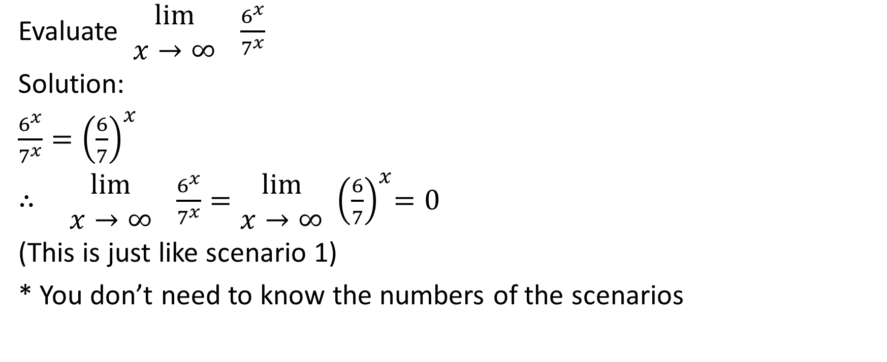
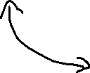
Evaluate $\begin{matrix}lim⁡ \\ x→∞\end{matrix} \frac{6^{x}}{7^{x}}$
Solution:
$\frac{6^{x}}{7^{x}}={\left(\frac{6}{7}\right)}^{x}$
$∴ \begin{matrix}lim⁡ \\ x→∞\end{matrix} \frac{6^{x}}{7^{x}}=\begin{matrix}lim⁡ \\ x→∞\end{matrix}$ ${ \left(\frac{6}{7}\right)}^{x}=0$
(This is just like scenario 1)
* You don’t need to know the numbers of the scenarios

Slide 28
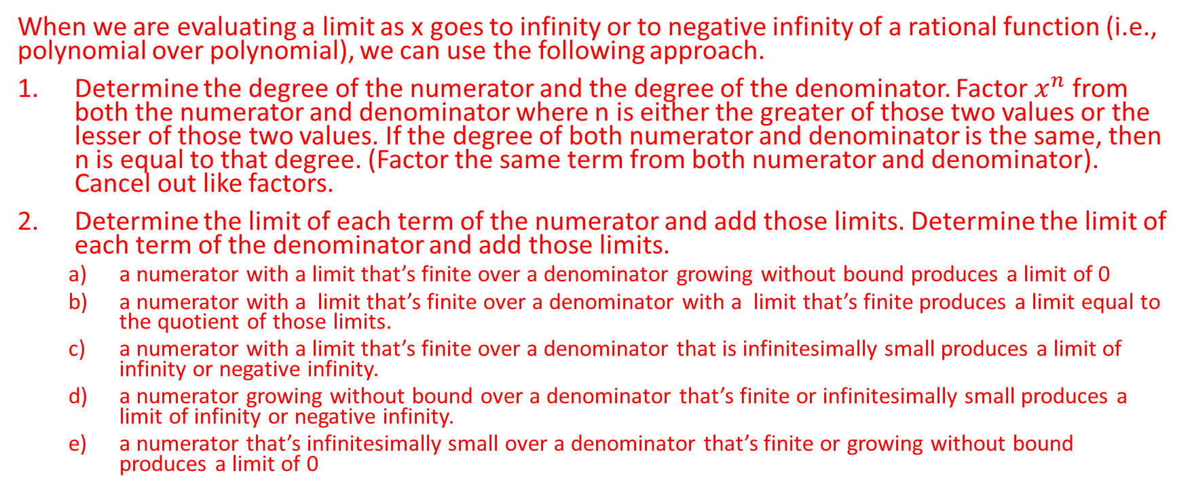
Limits as x goes to infinity or negative infinity: Rational Functions
When we are evaluating a limit as x goes to infinity or to negative infinity of a rational function (i.e., polynomial over polynomial), we can use the following approach.
Determine the degree of the numerator and the degree of the denominator. Factor $x^{n}$ from both the numerator and denominator where n is either the greater of those two values or the lesser of those two values. If the degree of both numerator and denominator is the same, then n is equal to that degree. (Factor the same term from both numerator and denominator). Cancel out like factors.
Determine the limit of each term of the numerator and add those limits. Determine the limit of each term of the denominator and add those limits.
a numerator with a limit that’s finite over a denominator growing without bound produces a limit of 0
a numerator with a limit that’s finite over a denominator with a limit that’s finite produces a limit equal to the quotient of those limits.
a numerator with a limit that’s finite over a denominator that is infinitesimally small produces a limit of infinity or negative infinity.
a numerator growing without bound over a denominator that’s finite or infinitesimally small produces a limit of infinity or negative infinity.
a numerator that’s infinitesimally small over a denominator that’s finite or growing without bound produces a limit of 0

Slide 29

Example
Evaluate $\begin{matrix}lim⁡ \\ x→∞\end{matrix} \frac{{5x}^{2}+2x+1}{3x+4}$

Slide 30
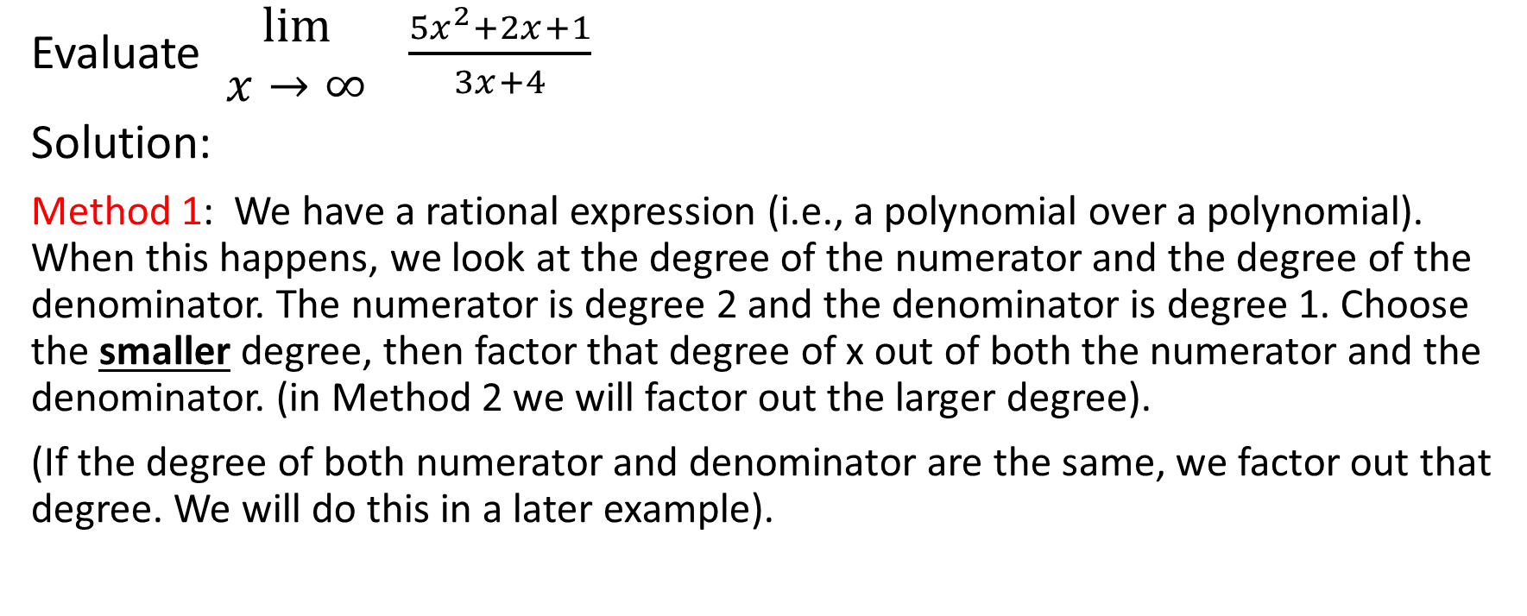
Evaluate $\begin{matrix}lim⁡ \\ x→∞\end{matrix} \frac{{5x}^{2}+2x+1}{3x+4}$
Solution:
Method 1: We have a rational expression (i.e., a polynomial over a polynomial). When this happens, we look at the degree of the numerator and the degree of the denominator. The numerator is degree 2 and the denominator is degree 1. Choose the smaller degree, then factor that degree of x out of both the numerator and the denominator. (in Method 2 we will factor out the larger degree).
(If the degree of both numerator and denominator are the same, we factor out that degree. We will do this in a later example).

Slide 31
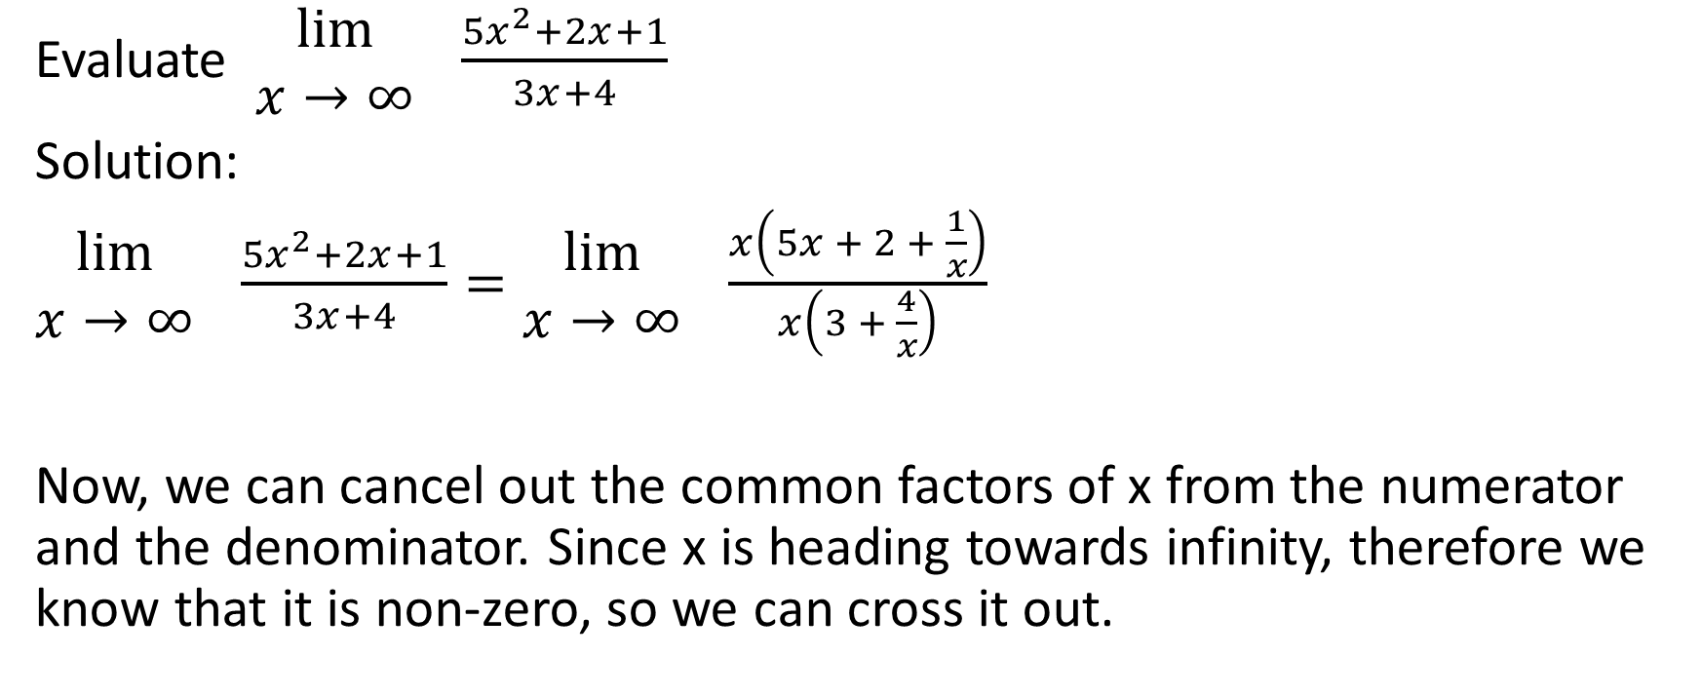

Evaluate $\begin{matrix}lim⁡ \\ x→∞\end{matrix} \frac{{5x}^{2}+2x+1}{3x+4}$
Solution:
$\begin{matrix}lim⁡ \\ x→∞\end{matrix} \frac{{5x}^{2}+2x+1}{3x+4}=\begin{matrix}lim⁡ \\ x→∞\end{matrix} \frac{x\left(5x + 2 + \frac{1}{x}\right)}{x\left(3 + \frac{4}{x}\right)}$
Now, we can cancel out the common factors of x from the numerator and the denominator. Since x is heading towards infinity, therefore we know that it is non-zero, so we can cross it out.

Slide 32
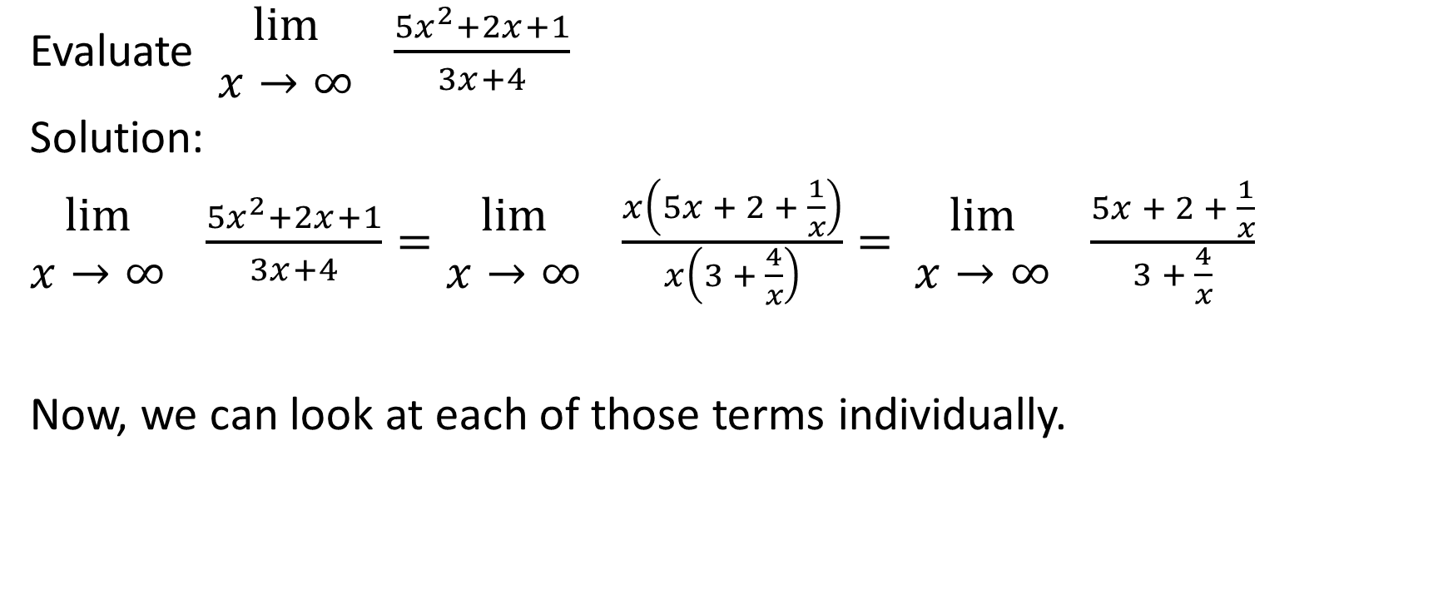


Evaluate $\begin{matrix}lim⁡ \\ x→∞\end{matrix} \frac{{5x}^{2}+2x+1}{3x+4}$
Solution:
$\begin{matrix}lim⁡ \\ x→∞\end{matrix} \frac{{5x}^{2}+2x+1}{3x+4}=\begin{matrix}lim⁡ \\ x→∞\end{matrix} \frac{x\left(5x + 2 + \frac{1}{x}\right)}{x\left(3 + \frac{4}{x}\right)}=$ $\begin{matrix}lim⁡ \\ x→∞\end{matrix} \frac{5x + 2 + \frac{1}{x}}{3 + \frac{4}{x}}$
Now, we can look at each of those terms individually.

Slide 33
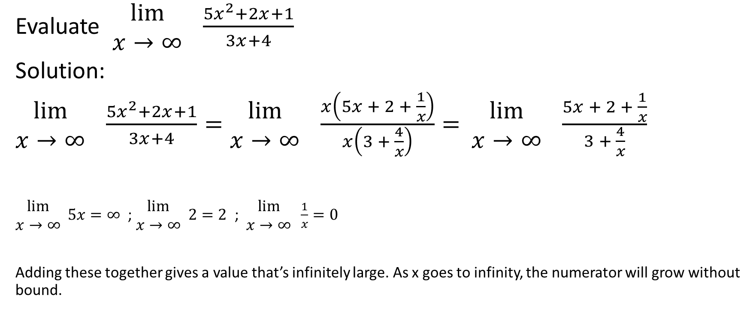
Evaluate $\begin{matrix}lim⁡ \\ x→∞\end{matrix} \frac{{5x}^{2}+2x+1}{3x+4}$
Solution:
$\begin{matrix}lim⁡ \\ x→∞\end{matrix} \frac{{5x}^{2}+2x+1}{3x+4}=\begin{matrix}lim⁡ \\ x→∞\end{matrix} \frac{x\left(5x + 2 + \frac{1}{x}\right)}{x\left(3 + \frac{4}{x}\right)}=$ $\begin{matrix}lim⁡ \\ x→∞\end{matrix} \frac{5x + 2 + \frac{1}{x}}{3 + \frac{4}{x}}$
$\begin{matrix}lim⁡ \\ x→∞\end{matrix} 5x=∞$ ; $\begin{matrix}lim⁡ \\ x→∞\end{matrix} 2=2$ ; $\begin{matrix}lim⁡ \\ x→∞\end{matrix} \frac{1}{x}=0$
Adding these together gives a value that’s infinitely large. As x goes to infinity, the numerator will grow without bound.

Slide 34
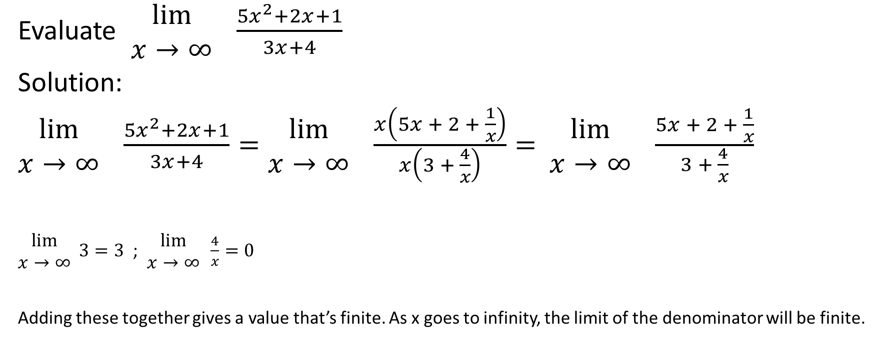
Evaluate $\begin{matrix}lim⁡ \\ x→∞\end{matrix} \frac{{5x}^{2}+2x+1}{3x+4}$
Solution:
$\begin{matrix}lim⁡ \\ x→∞\end{matrix} \frac{{5x}^{2}+2x+1}{3x+4}=\begin{matrix}lim⁡ \\ x→∞\end{matrix} \frac{x\left(5x + 2 + \frac{1}{x}\right)}{x\left(3 + \frac{4}{x}\right)}=$ $\begin{matrix}lim⁡ \\ x→∞\end{matrix} \frac{5x + 2 + \frac{1}{x}}{3 + \frac{4}{x}}$
$\begin{matrix}lim⁡ \\ x→∞\end{matrix} 3=3$ ; $\begin{matrix}lim⁡ \\ x→∞\end{matrix} \frac{4}{x}=0$
Adding these together gives a value that’s finite. As x goes to infinity, the limit of the denominator will be finite.

Slide 35
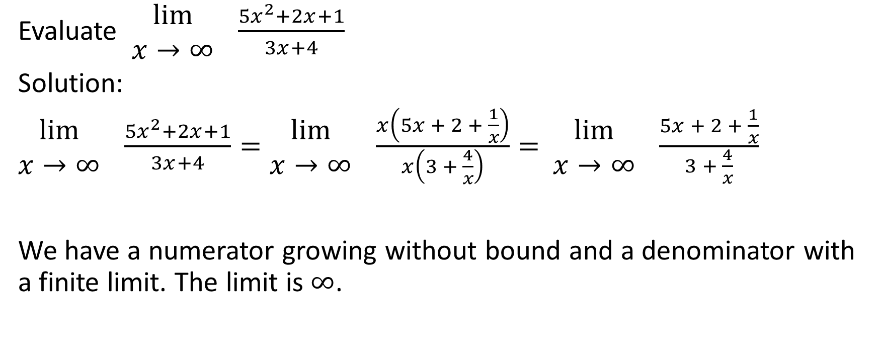
Evaluate $\begin{matrix}lim⁡ \\ x→∞\end{matrix} \frac{{5x}^{2}+2x+1}{3x+4}$
Solution:
$\begin{matrix}lim⁡ \\ x→∞\end{matrix} \frac{{5x}^{2}+2x+1}{3x+4}=\begin{matrix}lim⁡ \\ x→∞\end{matrix} \frac{x\left(5x + 2 + \frac{1}{x}\right)}{x\left(3 + \frac{4}{x}\right)}=$ $\begin{matrix}lim⁡ \\ x→∞\end{matrix} \frac{5x + 2 + \frac{1}{x}}{3 + \frac{4}{x}}$
We have a numerator growing without bound and a denominator with a finite limit. The limit is $∞$.

Slide 36
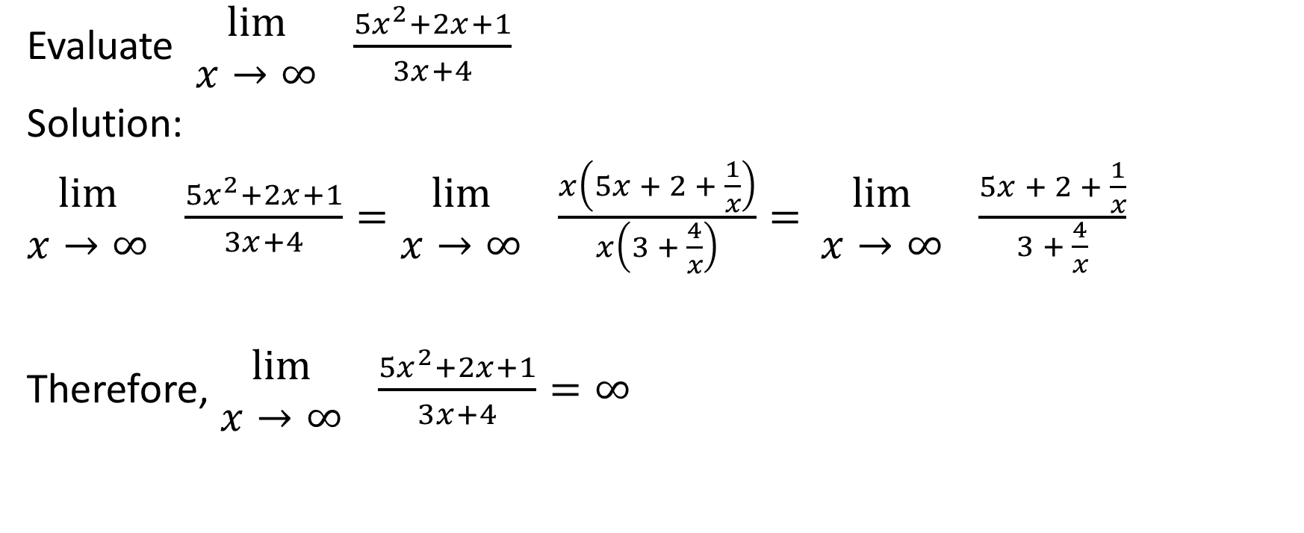
Evaluate $\begin{matrix}lim⁡ \\ x→∞\end{matrix} \frac{{5x}^{2}+2x+1}{3x+4}$
Solution:
$\begin{matrix}lim⁡ \\ x→∞\end{matrix} \frac{{5x}^{2}+2x+1}{3x+4}=\begin{matrix}lim⁡ \\ x→∞\end{matrix} \frac{x\left(5x + 2 + \frac{1}{x}\right)}{x\left(3 + \frac{4}{x}\right)}=$ $\begin{matrix}lim⁡ \\ x→∞\end{matrix} \frac{5x + 2 + \frac{1}{x}}{3 + \frac{4}{x}}$
Therefore, $\begin{matrix}lim⁡ \\ x→∞\end{matrix} \frac{{5x}^{2}+2x+1}{3x+4}=∞$

Slide 37
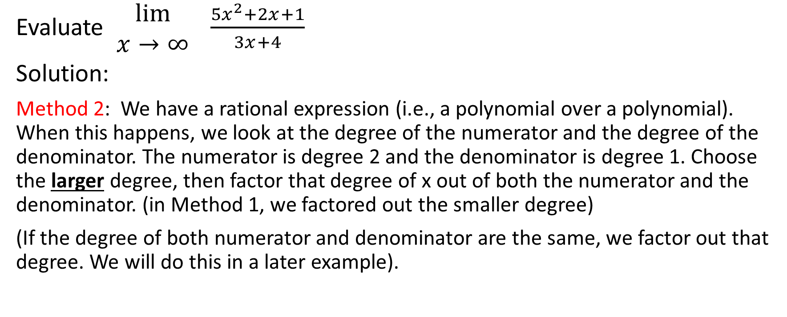
Evaluate $\begin{matrix}lim⁡ \\ x→∞\end{matrix} \frac{{5x}^{2}+2x+1}{3x+4}$
Solution:
Method 2: We have a rational expression (i.e., a polynomial over a polynomial). When this happens, we look at the degree of the numerator and the degree of the denominator. The numerator is degree 2 and the denominator is degree 1. Choose the larger degree, then factor that degree of x out of both the numerator and the denominator. (in Method 1, we factored out the smaller degree)
(If the degree of both numerator and denominator are the same, we factor out that degree. We will do this in a later example).

Slide 38
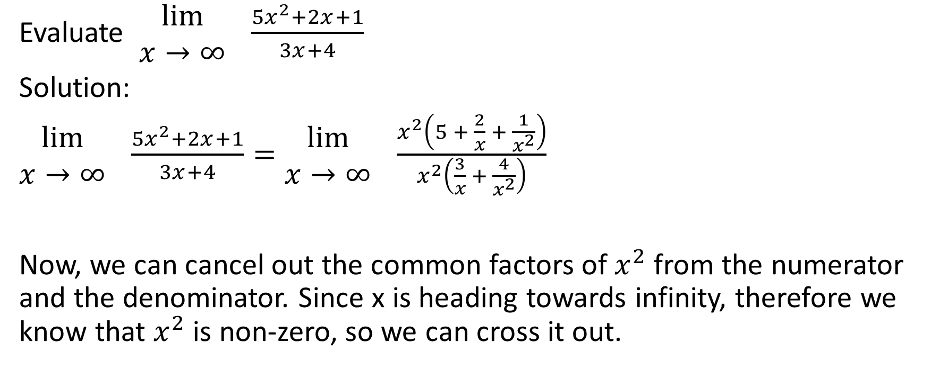
Evaluate $\begin{matrix}lim⁡ \\ x→∞\end{matrix} \frac{{5x}^{2}+2x+1}{3x+4}$
Solution:
$\begin{matrix}lim⁡ \\ x→∞\end{matrix} \frac{{5x}^{2}+2x+1}{3x+4}=\begin{matrix}lim⁡ \\ x→∞\end{matrix} \frac{x^{2}\left(5 + \frac{2}{x} + \frac{1}{x^{2}}\right)}{x^{2}\left(\frac{3}{x} + \frac{4}{x^{2}}\right)}$
Now, we can cancel out the common factors of $x^{2}$ from the numerator and the denominator. Since x is heading towards infinity, therefore we know that $x^{2}$ is non-zero, so we can cross it out.

Slide 39
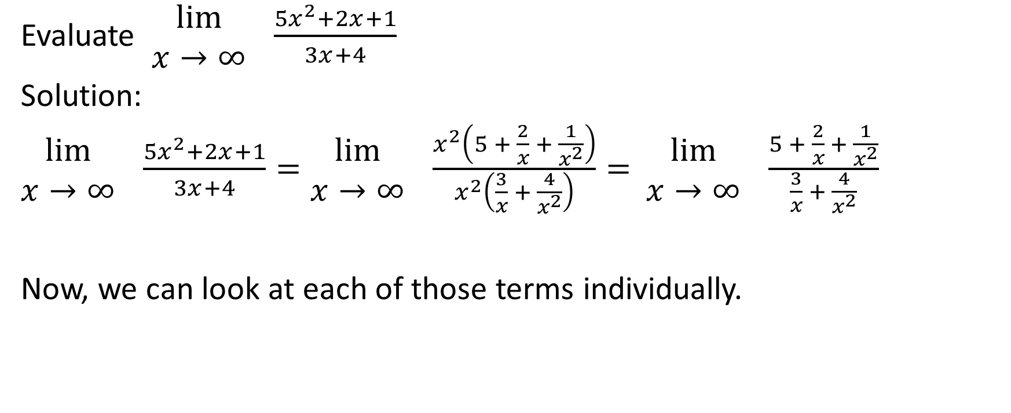


Evaluate $\begin{matrix}lim⁡ \\ x→∞\end{matrix} \frac{{5x}^{2}+2x+1}{3x+4}$
Solution:
$\begin{matrix}lim⁡ \\ x→∞\end{matrix} \frac{{5x}^{2}+2x+1}{3x+4}=\begin{matrix}lim⁡ \\ x→∞\end{matrix} \frac{x^{2}\left(5 + \frac{2}{x} + \frac{1}{x^{2}}\right)}{x^{2}\left(\frac{3}{x} + \frac{4}{x^{2}}\right)}=$ $\begin{matrix}lim⁡ \\ x→∞\end{matrix} \frac{5 + \frac{2}{x} + \frac{1}{x^{2}}}{\frac{3}{x} + \frac{4}{x^{2}}}$
Now, we can look at each of those terms individually.

Slide 40
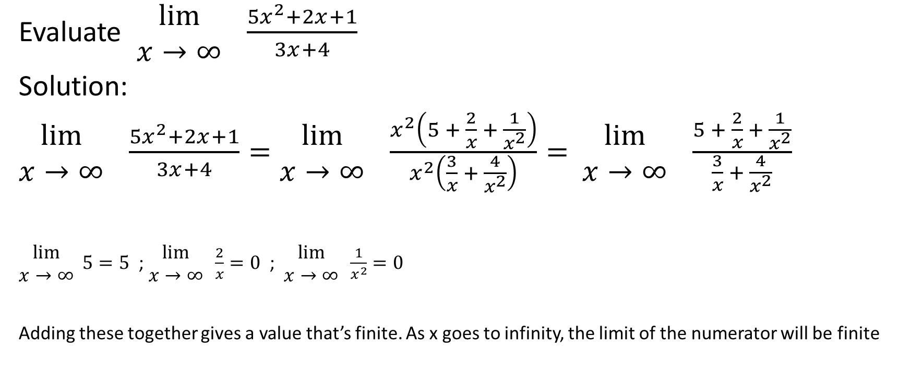

Evaluate $\begin{matrix}lim⁡ \\ x→∞\end{matrix} \frac{{5x}^{2}+2x+1}{3x+4}$
Solution:
$\begin{matrix}lim⁡ \\ x→∞\end{matrix} \frac{{5x}^{2}+2x+1}{3x+4}=\begin{matrix}lim⁡ \\ x→∞\end{matrix} \frac{x^{2}\left(5 + \frac{2}{x} + \frac{1}{x^{2}}\right)}{x^{2}\left(\frac{3}{x} + \frac{4}{x^{2}}\right)}=$ $\begin{matrix}lim⁡ \\ x→∞\end{matrix} \frac{5 + \frac{2}{x} + \frac{1}{x^{2}}}{\frac{3}{x} + \frac{4}{x^{2}}}$
$\begin{matrix}lim⁡ \\ x→∞\end{matrix} 5=5$ ; $\begin{matrix}lim⁡ \\ x→∞\end{matrix} \frac{2}{x}=0$ ; $\begin{matrix}lim⁡ \\ x→∞\end{matrix} \frac{1}{x^{2}}=0$
Adding these together gives a value that’s finite. As x goes to infinity, the limit of the numerator will be finite

Slide 41
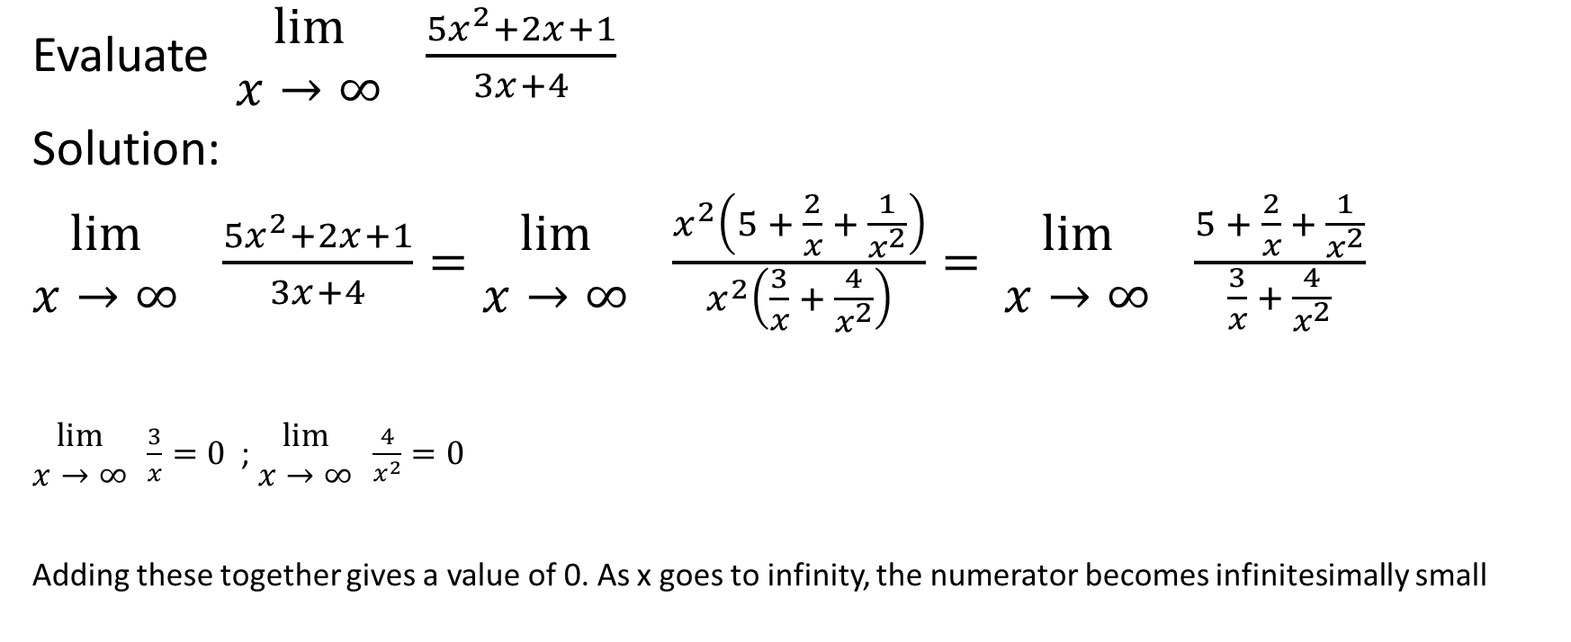


Evaluate $\begin{matrix}lim⁡ \\ x→∞\end{matrix} \frac{{5x}^{2}+2x+1}{3x+4}$
Solution:
$\begin{matrix}lim⁡ \\ x→∞\end{matrix} \frac{{5x}^{2}+2x+1}{3x+4}=\begin{matrix}lim⁡ \\ x→∞\end{matrix} \frac{x^{2}\left(5 + \frac{2}{x} + \frac{1}{x^{2}}\right)}{x^{2}\left(\frac{3}{x} + \frac{4}{x^{2}}\right)}=$ $\begin{matrix}lim⁡ \\ x→∞\end{matrix} \frac{5 + \frac{2}{x} + \frac{1}{x^{2}}}{\frac{3}{x} + \frac{4}{x^{2}}}$
$\begin{matrix}lim⁡ \\ x→∞\end{matrix} \frac{3}{x}=0$ ; $\begin{matrix}lim⁡ \\ x→∞\end{matrix} \frac{4}{x^{2}}=0$
Adding these together gives a value of 0. As x goes to infinity, the numerator becomes infinitesimally small

Slide 42
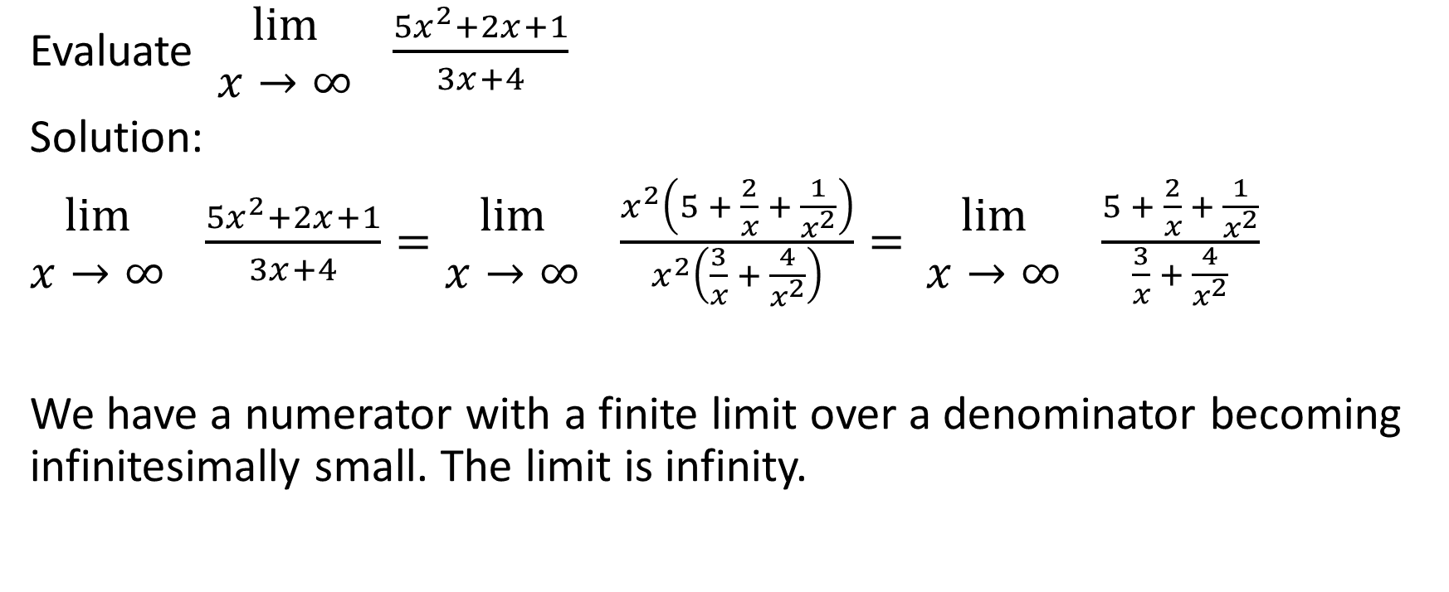

Evaluate $\begin{matrix}lim⁡ \\ x→∞\end{matrix} \frac{{5x}^{2}+2x+1}{3x+4}$
Solution:
$\begin{matrix}lim⁡ \\ x→∞\end{matrix} \frac{{5x}^{2}+2x+1}{3x+4}=\begin{matrix}lim⁡ \\ x→∞\end{matrix} \frac{x^{2}\left(5 + \frac{2}{x} + \frac{1}{x^{2}}\right)}{x^{2}\left(\frac{3}{x} + \frac{4}{x^{2}}\right)}=$ $\begin{matrix}lim⁡ \\ x→∞\end{matrix} \frac{5 + \frac{2}{x} + \frac{1}{x^{2}}}{\frac{3}{x} + \frac{4}{x^{2}}}$
We have a numerator with a finite limit over a denominator becoming infinitesimally small. The limit is infinity.

Slide 43
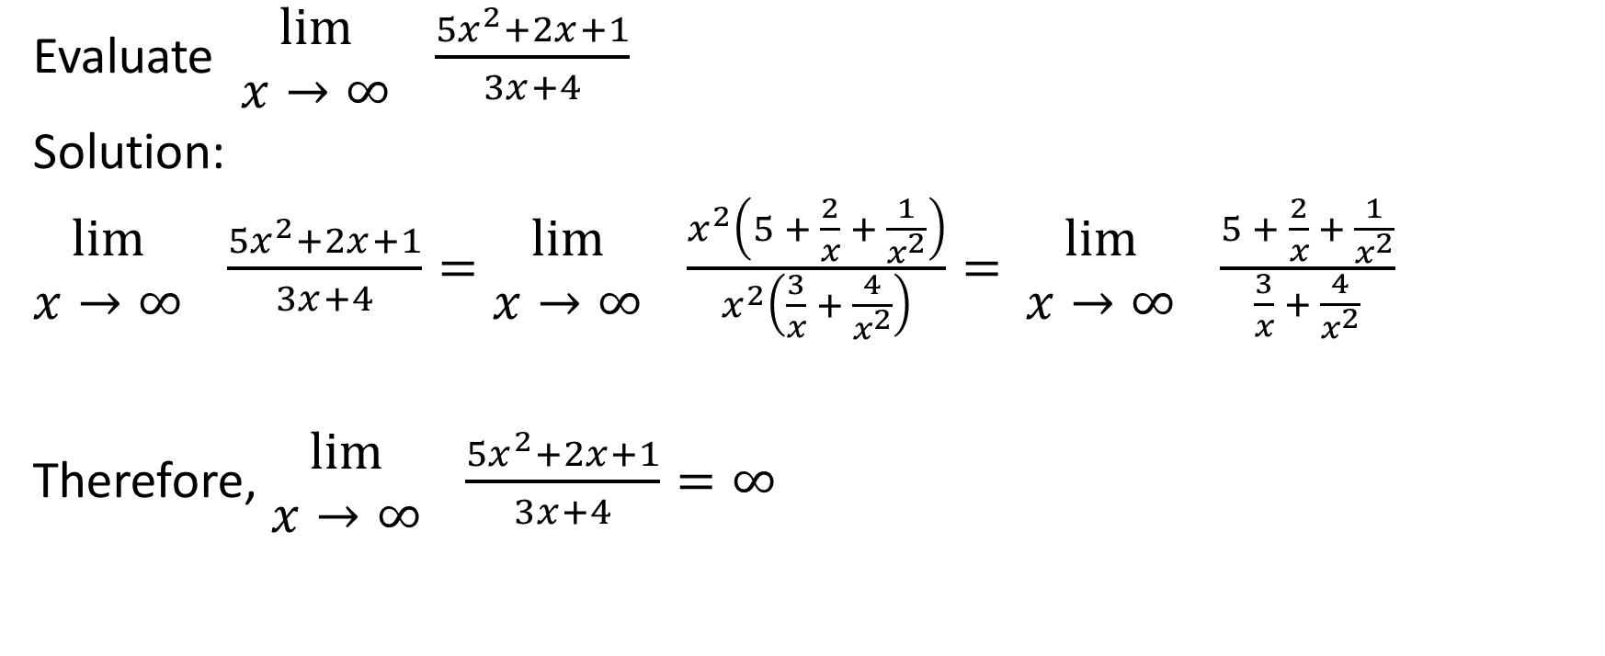

Evaluate $\begin{matrix}lim⁡ \\ x→∞\end{matrix} \frac{{5x}^{2}+2x+1}{3x+4}$
Solution:
$\begin{matrix}lim⁡ \\ x→∞\end{matrix} \frac{{5x}^{2}+2x+1}{3x+4}=\begin{matrix}lim⁡ \\ x→∞\end{matrix} \frac{x^{2}\left(5 + \frac{2}{x} + \frac{1}{x^{2}}\right)}{x^{2}\left(\frac{3}{x} + \frac{4}{x^{2}}\right)}=$ $\begin{matrix}lim⁡ \\ x→∞\end{matrix} \frac{5 + \frac{2}{x} + \frac{1}{x^{2}}}{\frac{3}{x} + \frac{4}{x^{2}}}$
Therefore, $\begin{matrix}lim⁡ \\ x→∞\end{matrix} \frac{{5x}^{2}+2x+1}{3x+4}=∞$

Slide 44
We’ll use Method 1 for the relevant questions for the rest of this slideshow.

Slide 45

Example
Evaluate
$\begin{matrix}lim⁡ \\ x→−∞\end{matrix} \frac{−6x^{3}−3x+1}{2x^{3}+5x^{2}−10x+5}$

Slide 46
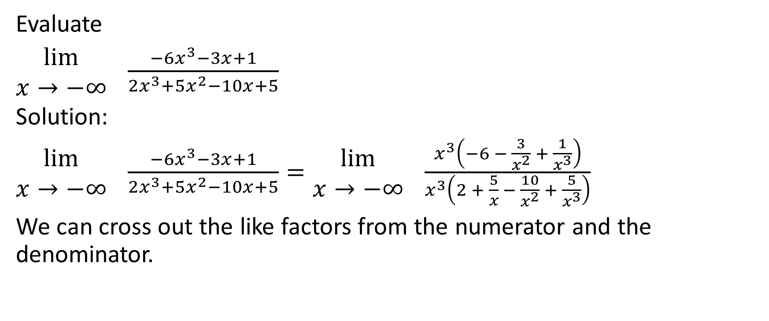
Evaluate
$\begin{matrix}lim⁡ \\ x→−∞\end{matrix} \frac{−6x^{3}−3x+1}{2x^{3}+5x^{2}−10x+5}$
Solution:
$\begin{matrix}lim⁡ \\ x→−∞\end{matrix} \frac{−6x^{3}−3x+1}{2x^{3}+5x^{2}−10x+5}=\begin{matrix}lim⁡ \\ x→−∞\end{matrix} \frac{x^{3}\left(−6 − \frac{3}{x^{2}} + \frac{1}{x^{3}}\right)}{x^{3}\left(2 + \frac{5}{x} − \frac{10}{x^{2}} + \frac{5}{x^{3}}\right)}$
We can cross out the like factors from the numerator and the denominator.

Slide 47
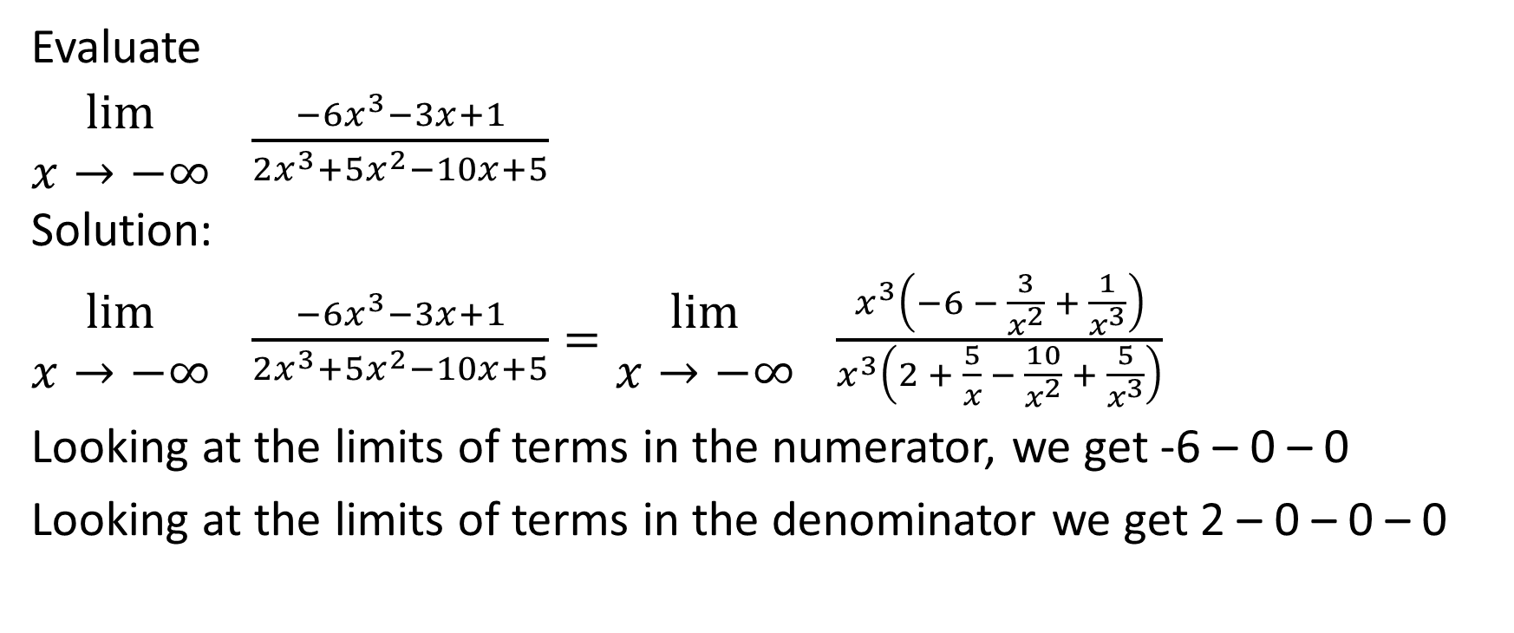
Evaluate
$\begin{matrix}lim⁡ \\ x→−∞\end{matrix} \frac{−6x^{3}−3x+1}{2x^{3}+5x^{2}−10x+5}$
Solution:
$\begin{matrix}lim⁡ \\ x→−∞\end{matrix} \frac{−6x^{3}−3x+1}{2x^{3}+5x^{2}−10x+5}=\begin{matrix}lim⁡ \\ x→−∞\end{matrix} \frac{x^{3}\left(−6 − \frac{3}{x^{2}} + \frac{1}{x^{3}}\right)}{x^{3}\left(2 + \frac{5}{x} − \frac{10}{x^{2}} + \frac{5}{x^{3}}\right)}$
Looking at the limits of terms in the numerator, we get -6 – 0 – 0
Looking at the limits of terms in the denominator we get 2 – 0 – 0 – 0

Slide 48
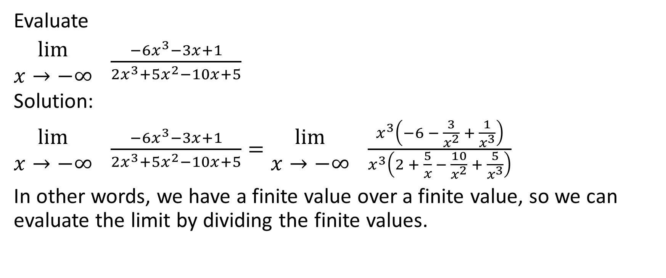
Evaluate
$\begin{matrix}lim⁡ \\ x→−∞\end{matrix} \frac{−6x^{3}−3x+1}{2x^{3}+5x^{2}−10x+5}$
Solution:
$\begin{matrix}lim⁡ \\ x→−∞\end{matrix} \frac{−6x^{3}−3x+1}{2x^{3}+5x^{2}−10x+5}=\begin{matrix}lim⁡ \\ x→−∞\end{matrix} \frac{x^{3}\left(−6 − \frac{3}{x^{2}} + \frac{1}{x^{3}}\right)}{x^{3}\left(2 + \frac{5}{x} − \frac{10}{x^{2}} + \frac{5}{x^{3}}\right)}$
In other words, we have a finite value over a finite value, so we can evaluate the limit by dividing the finite values.

Slide 49


Evaluate
$\begin{matrix}lim⁡ \\ x→−∞\end{matrix} \frac{−6x^{3}−3x+1}{2x^{3}+5x^{2}−10x+5}$
Solution:
$\begin{matrix}lim⁡ \\ x→−∞\end{matrix} \frac{−6x^{3}−3x+1}{2x^{3}+5x^{2}−10x+5}=\begin{matrix}lim⁡ \\ x→−∞\end{matrix} \frac{x^{3}\left(−6 − \frac{3}{x^{2}} + \frac{1}{x^{3}}\right)}{x^{3}\left(2 + \frac{5}{x} − \frac{10}{x^{2}} + \frac{5}{x^{3}}\right)}=\frac{−6−0−0}{2−0−0−0}$
$=\frac{−6}{2}=−3$

Slide 50

Example
Evaluate
$\begin{matrix}lim⁡ \\ x→∞\end{matrix}\frac{2x^{2}+x−9}{6x^{5}−4x^{4}−8x}$

Slide 51


Evaluate
$\begin{matrix}lim⁡ \\ x→∞\end{matrix} \frac{2x^{2}+x−9}{6x^{5}−4x^{4}−8x}$
Solution:
$\begin{matrix}lim⁡ \\ x→∞\end{matrix} \frac{2x^{2}+x−9}{6x^{5}−4x^{4}−8x}=\begin{matrix}lim⁡ \\ x→∞\end{matrix} \frac{x^{2}\left(2 + \frac{1}{x} − \frac{9}{x^{2}}\right)}{x^{2}\left(6x^{3} − 4x^{2} − \frac{8}{x}\right)}$
Now, we can cross out the like factors.

Slide 52

Evaluate
$\begin{matrix}lim⁡ \\ x→∞\end{matrix} \frac{2x^{2}+x−9}{6x^{5}−4x^{4}−8x}$
Solution:
$\begin{matrix}lim⁡ \\ x→∞\end{matrix} \frac{2x^{2}+x−9}{6x^{5}−4x^{4}−8x}=\begin{matrix}lim⁡ \\ x→∞\end{matrix} \frac{x^{2}\left(2 + \frac{1}{x} − \frac{9}{x^{2}}\right)}{x^{2}\left(6x^{3} − 4x^{2} − \frac{8}{x}\right)}$
Looking at the numerator, we add the limits of each of the terms and we get 2.

Slide 53



Evaluate
$\begin{matrix}lim⁡ \\ x→∞\end{matrix} \frac{2x^{2}+x−9}{6x^{5}−4x^{4}−8x}$
Solution:
$\begin{matrix}lim⁡ \\ x→∞\end{matrix} \frac{2x^{2}+x−9}{6x^{5}−4x^{4}−8x}=\begin{matrix}lim⁡ \\ x→∞\end{matrix} \frac{x^{2}\left(2 + \frac{1}{x} − \frac{9}{x^{2}}\right)}{x^{2}\left(6x^{3} − 4x^{2} − \frac{8}{x}\right)}$
Looking at the denominator, we can’t quite add the limits of each of the remaining terms because
$\begin{matrix}lim⁡ \\ x→∞\end{matrix} 6x^{3}=∞$ and $\begin{matrix}lim⁡ \\ x→∞\end{matrix} \left(−4x^{2}\right)=−∞$ . We can’t add $∞$ and $−∞$ to get 0 like we might do with real numbers. Instead, we can think of the end behavior of the function $y=6x^{3}−4x^{2}$.

Slide 54



Evaluate
$\begin{matrix}lim⁡ \\ x→∞\end{matrix} \frac{2x^{2}+x−9}{6x^{5}−4x^{4}−8x}$
Solution:
$\begin{matrix}lim⁡ \\ x→∞\end{matrix} \frac{2x^{2}+x−9}{6x^{5}−4x^{4}−8x}=\begin{matrix}lim⁡ \\ x→∞\end{matrix} \frac{x^{2}\left(2 + \frac{1}{x} − \frac{9}{x^{2}}\right)}{x^{2}\left(6x^{3} − 4x^{2} − \frac{8}{x}\right)}$
The function $y=6x^{3}−4x^{2}$has a positive leading coefficient and is degree 3. That means that as $x→∞$, $y→∞$. Therefore, we can think of the remaining terms in the denominator as
$\left(6x^{3}−4x^{2}\right)−\frac{8}{x}$. If we consider adding the limits of those two expressions, we have one expression heading towards infinity as $x→∞$ and the other heading to 0. Adding these together …

Slide 55

Evaluate
$\begin{matrix}lim⁡ \\ x→∞\end{matrix} \frac{2x^{2}+x−9}{6x^{5}−4x^{4}−8x}$
Solution:
$\begin{matrix}lim⁡ \\ x→∞\end{matrix} \frac{2x^{2}+x−9}{6x^{5}−4x^{4}−8x}=\begin{matrix}lim⁡ \\ x→∞\end{matrix} \frac{x^{2}\left(2 + \frac{1}{x} − \frac{9}{x^{2}}\right)}{x^{2}\left(6x^{3} − 4x^{2} − \frac{8}{x}\right)}$
means that we have denominator growing without bound. We have a finite numerator, so the limit is 0
Therefore, $\begin{matrix}lim⁡ \\ x→∞\end{matrix} \frac{2x^{2}+x−9}{6x^{5}−4x^{4}−8x}=0$

Slide 56

Example
Evaluate
$\begin{matrix}lim⁡ \\ x→∞\end{matrix} \frac{3x−4}{\sqrt{x^{2}−3}}$

Slide 57

Evaluate
$\begin{matrix}lim⁡ \\ x→∞\end{matrix} \frac{3x−4}{\sqrt{x^{2}−3}}$
Solution:
We can factor $x$ from the numerator and $\sqrt{x^{2}}$ from the denominator. Recall that $\sqrt{x^{2}}=\left|x\right|$.

Slide 58

Evaluate
$\begin{matrix}lim⁡ \\ x→∞\end{matrix} \frac{3x−4}{\sqrt{x^{2}−3}}$
Solution:
We can factor $x$ from the numerator and $\sqrt{x^{2}}$ from the denominator. Recall that $\sqrt{x^{2}}=\left|x\right|$.
Let’s take an aside to establish why we say that $\sqrt{x^{2}}=\left|x\right|$ and why we can’t just say that $\sqrt{x^{2}}=x$.
If we let $x=7$, then $\sqrt{x^{2}}=\sqrt{{(7)}^{2}}=\sqrt{49}=7=x$.
However, if we let $x=−7$, then $\sqrt{x^{2}}=\sqrt{{(−7)}^{2}}=\sqrt{49}=7=−x$.

Slide 59

Evaluate
$\begin{matrix}lim⁡ \\ x→∞\end{matrix} \frac{3x−4}{\sqrt{x^{2}−3}}$
Solution:
We can factor $x$ from the numerator and $\sqrt{x^{2}}$ from the denominator. Recall that $\sqrt{x^{2}}=\left|x\right|$.
In other words, when x is negative, $\sqrt{x^{2}}$ is positive. To be safe, we should always write that $\sqrt{x^{2}}=\left|x\right|$
Let’s take an aside to establish why we say that $\sqrt{x^{2}}=\left|x\right|$ and why we can’t just say that $\sqrt{x^{2}}=x$.
If we let $x=7$, then $\sqrt{x^{2}}=\sqrt{{(7)}^{2}}=\sqrt{49}=7=x$.
However, if we let $x=−7$, then $\sqrt{x^{2}}=\sqrt{{(−7)}^{2}}=\sqrt{49}=7=−x$.

Slide 60

Evaluate
$\begin{matrix}lim⁡ \\ x→∞\end{matrix} \frac{3x−4}{\sqrt{x^{2}−3}}$
Solution:
We can factor $x$ from the numerator and $\sqrt{x^{2}}$ from the denominator. Recall that $\sqrt{x^{2}}=\left|x\right|$.
$\begin{matrix}lim⁡ \\ x→∞\end{matrix} \frac{3x−4}{\sqrt{x^{2}−3}}=$ $\begin{matrix}lim⁡ \\ x→∞\end{matrix} \frac{x\left(3 − \frac{4}{x}\right)}{\sqrt{x^{2}\left(1 − \frac{3}{x^{2}}\right)}}=$ $\begin{matrix}lim⁡ \\ x→∞\end{matrix} \frac{x\left(3 − \frac{4}{x}\right)}{\sqrt{x^{2}}\sqrt{\left(1 − \frac{3}{x^{2}}\right)}}=$ $\begin{matrix}lim⁡ \\ x→∞\end{matrix} \frac{x\left(3 − \frac{4}{x}\right)}{\left|x\right|\sqrt{\left(1 − \frac{3}{x^{2}}\right)}}$

Slide 61

Evaluate
$\begin{matrix}lim⁡ \\ x→∞\end{matrix} \frac{3x−4}{\sqrt{x^{2}−3}}$
Solution:
$\begin{matrix}lim⁡ \\ x→∞\end{matrix} \frac{x\left(3 − \frac{4}{x}\right)}{\left|x\right|\sqrt{\left(1 − \frac{3}{x^{2}}\right)}}$
We can sub in a factor of $x$ in the denominator rather than a factor of $\left|x\right|$. The reason for this is that x is heading to positive infinity, so x is taking on positive values in this question. We know that the absolute value of a positive number is just the number itself. Therefore, in this case, we know that $\left|x\right|=x$

Slide 62

Evaluate
$\begin{matrix}lim⁡ \\ x→∞\end{matrix} \frac{3x−4}{\sqrt{x^{2}−3}}$
Solution:
$\begin{matrix}lim⁡ \\ x→∞\end{matrix} \frac{x\left(3 − \frac{4}{x}\right)}{\left|x\right|\sqrt{\left(1 − \frac{3}{x^{2}}\right)}}=$ $\begin{matrix}lim⁡ \\ x→∞\end{matrix} \frac{x\left(3 − \frac{4}{x}\right)}{(x)\sqrt{\left(1 − \frac{3}{x^{2}}\right)}}$
We can sub in a factor of $x$ in the denominator rather than a factor of $\left|x\right|$. The reason for this is that x is heading to positive infinity, so x is taking on positive values in this question. We know that the absolute value of a positive number is just the number itself. Therefore, in this case, we know that $\left|x\right|=x$

Slide 63

Evaluate
$\begin{matrix}lim⁡ \\ x→∞\end{matrix} \frac{3x−4}{\sqrt{x^{2}−3}}$
Solution:
$\begin{matrix}lim⁡ \\ x→∞\end{matrix} \frac{x\left(3 − \frac{4}{x}\right)}{\left|x\right|\sqrt{\left(1 − \frac{3}{x^{2}}\right)}}=$ $\begin{matrix}lim⁡ \\ x→∞\end{matrix} \frac{x\left(3 − \frac{4}{x}\right)}{(x)\sqrt{\left(1 − \frac{3}{x^{2}}\right)}}$
Now, we can eliminate the like factors from the numerator and the denominator.

Slide 64

Evaluate
$\begin{matrix}lim⁡ \\ x→∞\end{matrix} \frac{3x−4}{\sqrt{x^{2}−3}}$
Solution:
$\begin{matrix}lim⁡ \\ x→∞\end{matrix} \frac{x\left(3 − \frac{4}{x}\right)}{\left|x\right|\sqrt{\left(1 − \frac{3}{x^{2}}\right)}}=$ $\begin{matrix}lim⁡ \\ x→∞\end{matrix} \frac{x\left(3 − \frac{4}{x}\right)}{(x)\sqrt{\left(1 − \frac{3}{x^{2}}\right)}}$
Now, we can evaluate the limit of each of the terms remaining in the expression as x goes to infinity.

Slide 65

Evaluate
$\begin{matrix}lim⁡ \\ x→∞\end{matrix} \frac{3x−4}{\sqrt{x^{2}−3}}$
Solution:
$\begin{matrix}lim⁡ \\ x→∞\end{matrix} \frac{x\left(3 − \frac{4}{x}\right)}{\left|x\right|\sqrt{\left(1 − \frac{3}{x^{2}}\right)}}=$ $\begin{matrix}lim⁡ \\ x→∞\end{matrix} \frac{x\left(3 − \frac{4}{x}\right)}{(x)\sqrt{\left(1 − \frac{3}{x^{2}}\right)}}$
In the numerator,
$\begin{matrix}lim⁡ \\ x→∞\end{matrix} 3=3$ and $\begin{matrix}lim⁡ \\ x→∞\end{matrix} \frac{4}{x}=0$

Slide 66

Evaluate
$\begin{matrix}lim⁡ \\ x→∞\end{matrix} \frac{3x−4}{\sqrt{x^{2}−3}}$
Solution:
$\begin{matrix}lim⁡ \\ x→∞\end{matrix} \frac{x\left(3 − \frac{4}{x}\right)}{\left|x\right|\sqrt{\left(1 − \frac{3}{x^{2}}\right)}}=$ $\begin{matrix}lim⁡ \\ x→∞\end{matrix} \frac{x\left(3 − \frac{4}{x}\right)}{(x)\sqrt{\left(1 − \frac{3}{x^{2}}\right)}}$
In the denominator,
$\begin{matrix}lim⁡ \\ x→∞\end{matrix} 1=1$ and $\begin{matrix}lim⁡ \\ x→∞\end{matrix} \frac{3}{x^{2}}=0$

Slide 67

Evaluate
$\begin{matrix}lim⁡ \\ x→∞\end{matrix} \frac{3x−4}{\sqrt{x^{2}−3}}$
Solution:
$\begin{matrix}lim⁡ \\ x→∞\end{matrix} \frac{x\left(3 − \frac{4}{x}\right)}{\left|x\right|\sqrt{\left(1 − \frac{3}{x^{2}}\right)}}=$ $\begin{matrix}lim⁡ \\ x→∞\end{matrix} \frac{x\left(3 − \frac{4}{x}\right)}{(x)\sqrt{\left(1 − \frac{3}{x^{2}}\right)}}=\frac{3−0}{\sqrt{1−0}}=\frac{3}{1}=3$

Slide 68

Example
Evaluate
$\begin{matrix}lim⁡ \\ x→−∞\end{matrix} \frac{3x−4}{\sqrt{x^{2}−3}}$

Slide 69

Evaluate
$\begin{matrix}lim⁡ \\ x→−∞\end{matrix} \frac{3x−4}{\sqrt{x^{2}−3}}$
Solution:
We can factor $x$ from the numerator and $\sqrt{x^{2}}$ from the denominator. Recall that $\sqrt{x^{2}}=\left|x\right|$.

Slide 70
Evaluate
$\begin{matrix}lim⁡ \\ x→−∞\end{matrix} \frac{3x−4}{\sqrt{x^{2}−3}}$
Solution:
We can factor $x$ from the numerator and $\sqrt{x^{2}}$ from the denominator. Recall that $\sqrt{x^{2}}=\left|x\right|$.
Let’s take an aside to establish why we say that $\sqrt{x^{2}}=\left|x\right|$ and why we can’t just say that $\sqrt{x^{2}}=x$.
If we let $x=7$, then $\sqrt{x^{2}}=\sqrt{{(7)}^{2}}=\sqrt{49}=7=x$.
However, if we let $x=−7$, then $\sqrt{x^{2}}=\sqrt{{(−7)}^{2}}=\sqrt{49}=7=−x$.

Slide 71
Evaluate
$\begin{matrix}lim⁡ \\ x→−∞\end{matrix} \frac{3x−4}{\sqrt{x^{2}−3}}$
Solution:
We can factor $x$ from the numerator and $\sqrt{x^{2}}$ from the denominator. Recall that $\sqrt{x^{2}}=\left|x\right|$.
In other words, when x is negative, $\sqrt{x^{2}}$ is positive. To be safe, we should always write that $\sqrt{x^{2}}=\left|x\right|$
Let’s take an aside to establish why we say that $\sqrt{x^{2}}=\left|x\right|$ and why we can’t just say that $\sqrt{x^{2}}=x$.
If we let $x=7$, then $\sqrt{x^{2}}=\sqrt{{(7)}^{2}}=\sqrt{49}=7=x$.
However, if we let $x=−7$, then $\sqrt{x^{2}}=\sqrt{{(−7)}^{2}}=\sqrt{49}=7=−x$.

Slide 72

Evaluate
$\begin{matrix}lim⁡ \\ x→−∞\end{matrix} \frac{3x−4}{\sqrt{x^{2}−3}}$
Solution:
We can factor $x$ from the numerator and $\sqrt{x^{2}}$ from the denominator. Recall that $\sqrt{x^{2}}=\left|x\right|$.
$\begin{matrix}lim⁡ \\ x→−∞\end{matrix} \frac{3x−4}{\sqrt{x^{2}−3}}=$ $\begin{matrix}lim⁡ \\ x→−∞\end{matrix} \frac{x\left(3 − \frac{4}{x}\right)}{\sqrt{x^{2}\left(1 − \frac{3}{x^{2}}\right)}}=$ $\begin{matrix}lim⁡ \\ x→=∞\end{matrix} \frac{x\left(3 − \frac{4}{x}\right)}{\sqrt{x^{2}}\sqrt{\left(1 − \frac{3}{x^{2}}\right)}}=$ $\begin{matrix}lim⁡ \\ x→−∞\end{matrix} \frac{x\left(3 − \frac{4}{x}\right)}{\left|x\right|\sqrt{\left(1 − \frac{3}{x^{2}}\right)}}$

Slide 73

Evaluate
$\begin{matrix}lim⁡ \\ x→−∞\end{matrix} \frac{3x−4}{\sqrt{x^{2}−3}}$
Solution:
$\begin{matrix}lim⁡ \\ x→−∞\end{matrix} \frac{x\left(3 − \frac{4}{x}\right)}{\left|x\right|\sqrt{\left(1 − \frac{3}{x^{2}}\right)}}$
We can sub in a factor of $(−x)$ in the denominator rather than a factor of $\left|x\right|$. The reason for this is that x is heading to negative infinity, so x is taking on negative values in this question. We know that the absolute value of a negative number is just -1 times the number itself. For example, $\left|−7\right|=−\left(−7\right)=7$. Hence, in this case, we know $\left|x\right|=(−x)$

Slide 74

Evaluate
$\begin{matrix}lim⁡ \\ x→−∞\end{matrix} \frac{3x−4}{\sqrt{x^{2}−3}}$
Solution:
$\begin{matrix}lim⁡ \\ x→−∞\end{matrix} \frac{x\left(3 − \frac{4}{x}\right)}{\left|x\right|\sqrt{\left(1 − \frac{3}{x^{2}}\right)}}=$ $\begin{matrix}lim⁡ \\ x→−∞\end{matrix} \frac{x\left(3 − \frac{4}{x}\right)}{(−x)\sqrt{\left(1 − \frac{3}{x^{2}}\right)}}$

Slide 75

Evaluate
$\begin{matrix}lim⁡ \\ x→−∞\end{matrix} \frac{3x−4}{\sqrt{x^{2}−3}}$
Solution:
$\begin{matrix}lim⁡ \\ x→−∞\end{matrix} \frac{x\left(3 − \frac{4}{x}\right)}{\left|x\right|\sqrt{\left(1 − \frac{3}{x^{2}}\right)}}=$ $\begin{matrix}lim⁡ \\ x→−∞\end{matrix} \frac{x\left(3 − \frac{4}{x}\right)}{(−1)(x)\sqrt{\left(1 − \frac{3}{x^{2}}\right)}}$
Now, we can eliminate the like factors from the numerator and the denominator.

Slide 76

Evaluate
$\begin{matrix}lim⁡ \\ x→−∞\end{matrix} \frac{3x−4}{\sqrt{x^{2}−3}}$
Solution:
$\begin{matrix}lim⁡ \\ x→−∞\end{matrix} \frac{x\left(3 − \frac{4}{x}\right)}{\left|x\right|\sqrt{\left(1 − \frac{3}{x^{2}}\right)}}=$ $\begin{matrix}lim⁡ \\ x→−∞\end{matrix} \frac{x\left(3 − \frac{4}{x}\right)}{(−1)(x)\sqrt{\left(1 − \frac{3}{x^{2}}\right)}}$
Now, we can evaluate the limit of each of the terms remaining in the expression as x goes to negative infinity.

Slide 77

Evaluate
$\begin{matrix}lim⁡ \\ x→−∞\end{matrix} \frac{3x−4}{\sqrt{x^{2}−3}}$
Solution:
$\begin{matrix}lim⁡ \\ x→−∞\end{matrix} \frac{x\left(3 − \frac{4}{x}\right)}{\left|x\right|\sqrt{\left(1 − \frac{3}{x^{2}}\right)}}=$ $\begin{matrix}lim⁡ \\ x→−∞\end{matrix} \frac{x\left(3 − \frac{4}{x}\right)}{(−1)(x)\sqrt{\left(1 − \frac{3}{x^{2}}\right)}}$
In the numerator,
$\begin{matrix}lim⁡ \\ x→−∞\end{matrix} 3=3$ and $\begin{matrix}lim⁡ \\ x→−∞\end{matrix} \frac{4}{x}=0$

Slide 78

Evaluate
$\begin{matrix}lim⁡ \\ x→−∞\end{matrix} \frac{3x−4}{\sqrt{x^{2}−3}}$
Solution:
$\begin{matrix}lim⁡ \\ x→−∞\end{matrix} \frac{x\left(3 − \frac{4}{x}\right)}{\left|x\right|\sqrt{\left(1 − \frac{3}{x^{2}}\right)}}=$ $\begin{matrix}lim⁡ \\ x→−∞\end{matrix} \frac{x\left(3 − \frac{4}{x}\right)}{(−1)(x)\sqrt{\left(1 − \frac{3}{x^{2}}\right)}}$
In the denominator,
$\begin{matrix}lim⁡ \\ x→−∞\end{matrix} 1=1$ and $\begin{matrix}lim⁡ \\ x→−∞\end{matrix} \frac{3}{x^{2}}=0$

Slide 79

Evaluate
$\begin{matrix}lim⁡ \\ x→−∞\end{matrix} \frac{3x−4}{\sqrt{x^{2}−3}}$
Solution:
$\begin{matrix}lim⁡ \\ x→−∞\end{matrix} \frac{x\left(3 − \frac{4}{x}\right)}{\left|x\right|\sqrt{\left(1 − \frac{3}{x^{2}}\right)}}=$ $\begin{matrix}lim⁡ \\ x→−∞\end{matrix} \frac{x\left(3 − \frac{4}{x}\right)}{(−1)(x)\sqrt{\left(1 − \frac{3}{x^{2}}\right)}}=\frac{3+0}{(−1)\sqrt{1−0}}=\frac{3}{(−1)1}=\frac{3}{−1}=−3$

